Slide 1
Continuous Learning
Regis Chasse, Global Curriculum Dept. Director- Capgemini
Mindi Forth, Curriculum Director – Capgemini
Cindy Miller, Senior Learning Program Architect – Skillsoft
Kristin Shackelford, Senior Customer Success Consultant- Skillsoft

Slide 2
Agenda
Welcome!
Introductions
Cindy Miller
Regis Chasse
Mindi Forth
Kristin Shackelford
“Putting the Pieces Together”
Goals and Session Outcomes
What?
Why?
How?
Synthesize
Notes:
Welcome-Cindy
Recap workshop title, etc.
Intro’s-Cindy facilitate
Facilitate a fun fact -
Ice-breakers- Cindy
(icebreaker)– Take survey results (obstacles related to CL) groups of 10, write down 1 obstacle per piece –writing it on the blank puzzle piece – individual issues become put together in one
Don’t fill out all of the puzzle pieces – leave blank and as you go through the workshop – fill out (in different color sharpie) some key ideas that can complete the puzzle/picture - be prepared to share at the end.
Goals for Session:
Goals for Session- Kristin
What: Expand narrative/definition of CL and what it may mean to you/your organization , learn from others how they implemented CL principles for specific initiatives, for you to walk away with some key actions you can implement right away in your organization
Why: Benefits of considering CL in your environment
How: You’ll hear directly from Regis and Mindi who have implemented two flavors of Continuous Learning to support specific outcomes. Learn from their successes and what processes – beyond just the design of the learning intervention- were modified to expand the definition of CL within Capgemini.
Walk away with some quick wins/ways to tangibly begin considering opportunities to implement an expanded continuous learning mindset within your organization.
What is Continuous Learning? Share some of the survey results you graciously took the time to complete to help us level set this group of participants today.
Facilitate discussion – share back findings
Share back Obstacles –
Review how historically CL was often considered just in terms of the “content mix/delivery” – here to expand that to review other areas of consideration that xxxxxx
range from organizational expectations and increased pressure on HR to align to and deliver against critical business outcomes, responding to the needs and expectations of today’s employee, cost savings (time costs, effort costs, real hard costs), and how the human condition impacts should shape shift our considerations for delivering more effective learning solutions.

Slide 3
What?
Notes:
Define Continuous Learning feedback from results – not one answer – hope that your answer when you leave will be more expansive in terms of your tools and ways you can operationalize continuous learning in your organization.
What is Continuous Learning? Share some of the survey results you graciously took the time to complete to help us level set this group of participants today.
Facilitate discussion – share back findings
Share back Obstacles –Did that in a creative way with the puzzle, but could we have someone from each group share some key obstacles?
Review how historically CL was often considered just in terms of the “content mix/delivery” – here to expand that to review other areas of consideration that can expand your ability to respond to the learning crisis.
http://blog.learnlets.com/?p=4272
.

Slide 4
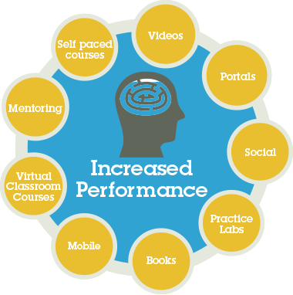
What? Multi-modal learning
Notes:
Review how historically CL was often considered just in terms of the “content mix/delivery”
Very important to “know your content repertoire”, consider your learner tolerances – bandwidth for learning, learning environment (do they need mobile, etc.)
Does anyone see anything missing here?
Does anyone see a specific modality they need clarification on or perhaps maybe you were triggered to consider another modality often forgotten in the learning design?
Not designed to be fully comprehensive- but to demonstrate the many options we have available today because of the medium of technology.
One that is getting more attention – and rightly so is mixing in “Reflection” time – between Learn and Apply –because of our high paced environments, we’re finding we need to be intentional in our design to include reflection time in the process
This leads to us ensuring we extrapolate the CL mindset beyond just content and into the processes we impact and how we use technology to power the learning and empower the learner.

Slide 5
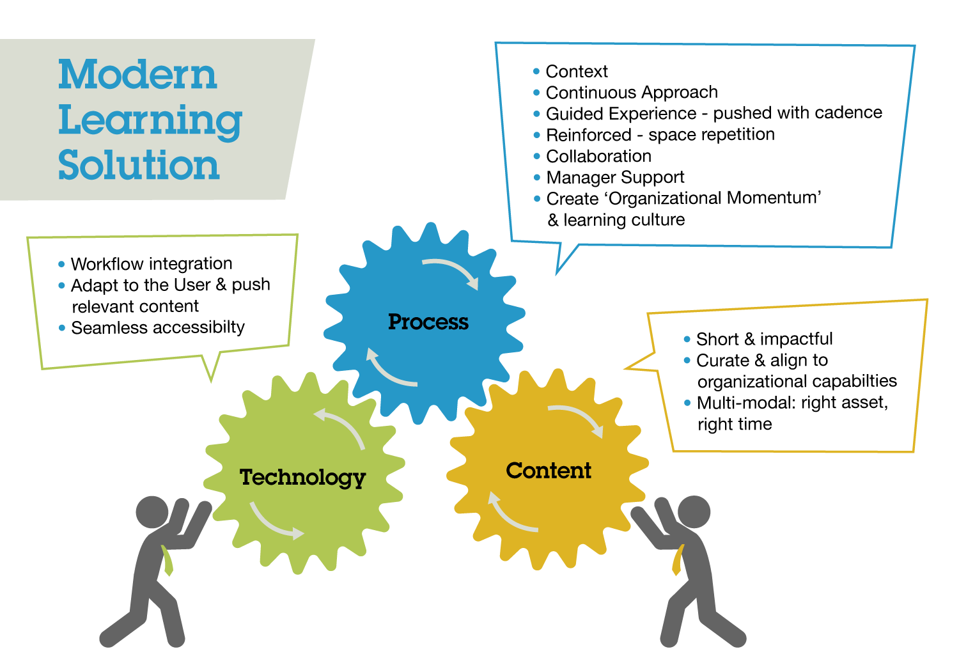
What? Firing all cylinders
Notes:
Consider this a Continuous Learning Framework. Considering these elements will help you successfully move beyond just creating learning for learning’s sake, but create the organizational momentum learning is capable of delivering.
After all, when we learn better – we perform better.
Technology – Available, Visible, Accessible
Enable the learning and empower the learner
Consider these elements and feel free to use your hand out to make notes/document content modalities, technologies and/or processes you may not have considered before – after you hear from Regis and Mindi.

Slide 6
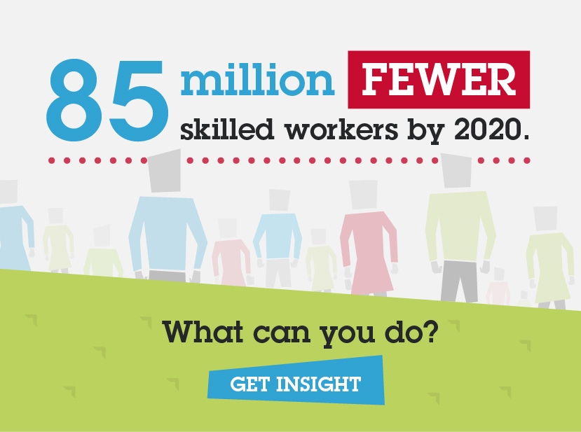
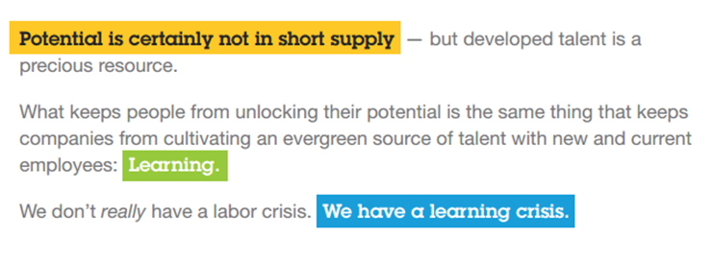
Why? The Learning Crisis
Notes:
Nothing new in terms of information – but raises the visibility and the importance of the work you and your team are chartered to do.
The good news is that the global economy is steadily improving. Economic improvement allows organizations to take action on all of these trends, invest in their employees, and get ahead of the competition.
Economic success and change can be disruptive, though. In fact, by the year 2020 — just five years from now — there will be 85 million fewer skilled workers than businesses need to succeed.
http://www.mckinsey.com/insights/employment_and_growth/the_world_at_work
By 2020 – expected to be 85 million fewer skilled workers available – not fewer people – that’s rising, it’s the workers with the right skills to the job that is what has been defined as “the Learning Crisis”

Slide 7
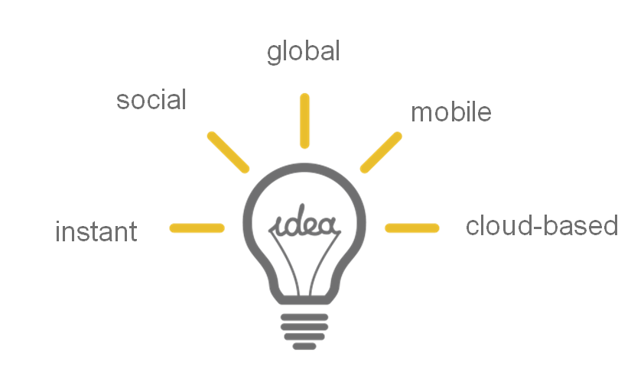

Why?
Notes:
Expectations – be “best in class” – for organizations that want to be “leaders in the industry” the future is now –
Professor of London School of Business and well-known speaker/author – Lynda Gratton states in her book, Shift – “The future of work is now”
This is a great opportunity for us to combine the “future of work is now” mindset with the “future of learning is now mindset” and optimize our learning deliverable to optimize the work of today/tomorrow
Reasons range from organizational expectations and increased pressure on HR to align to and deliver against critical business outcomes, responding to the needs and expectations of today’s employee, cost savings (time costs, effort costs, real hard costs), and how the human condition impacts should shape shift our considerations for delivering more effective learning solutions

Slide 8
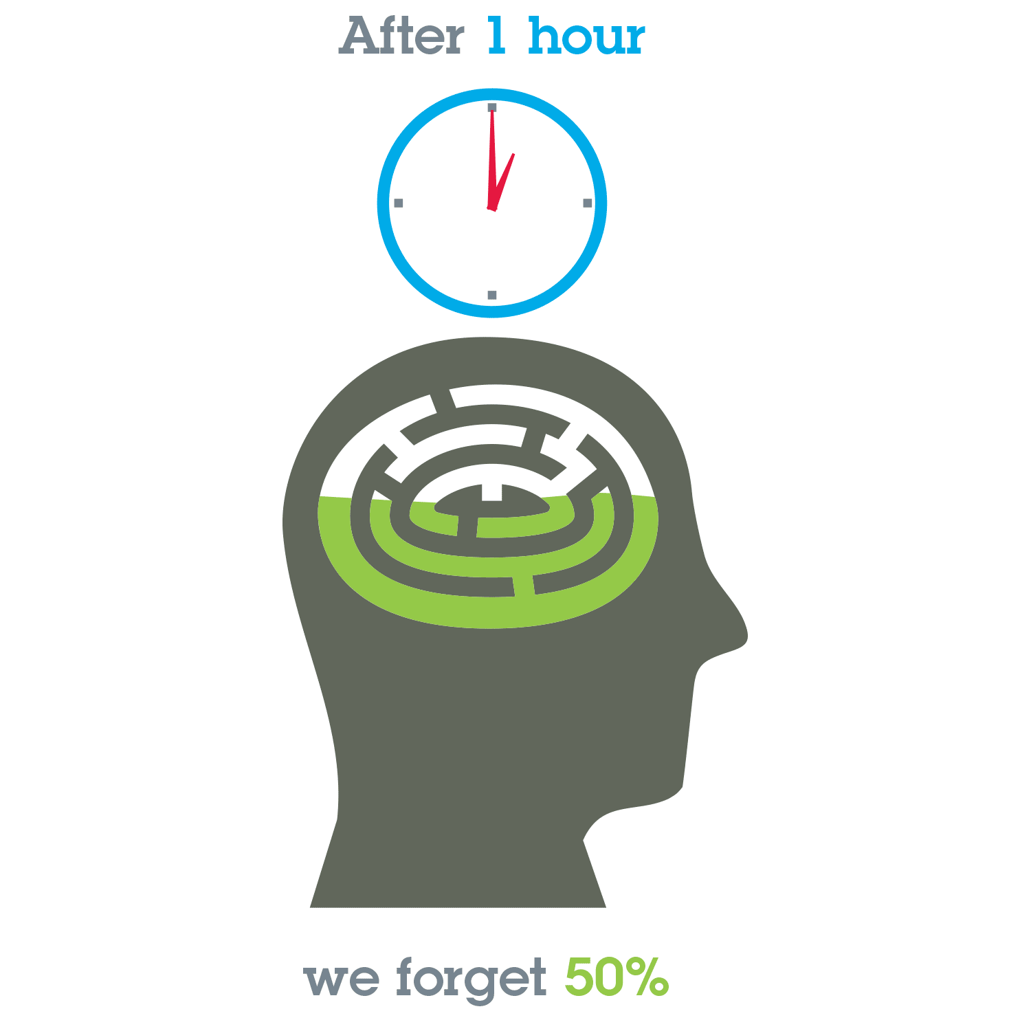
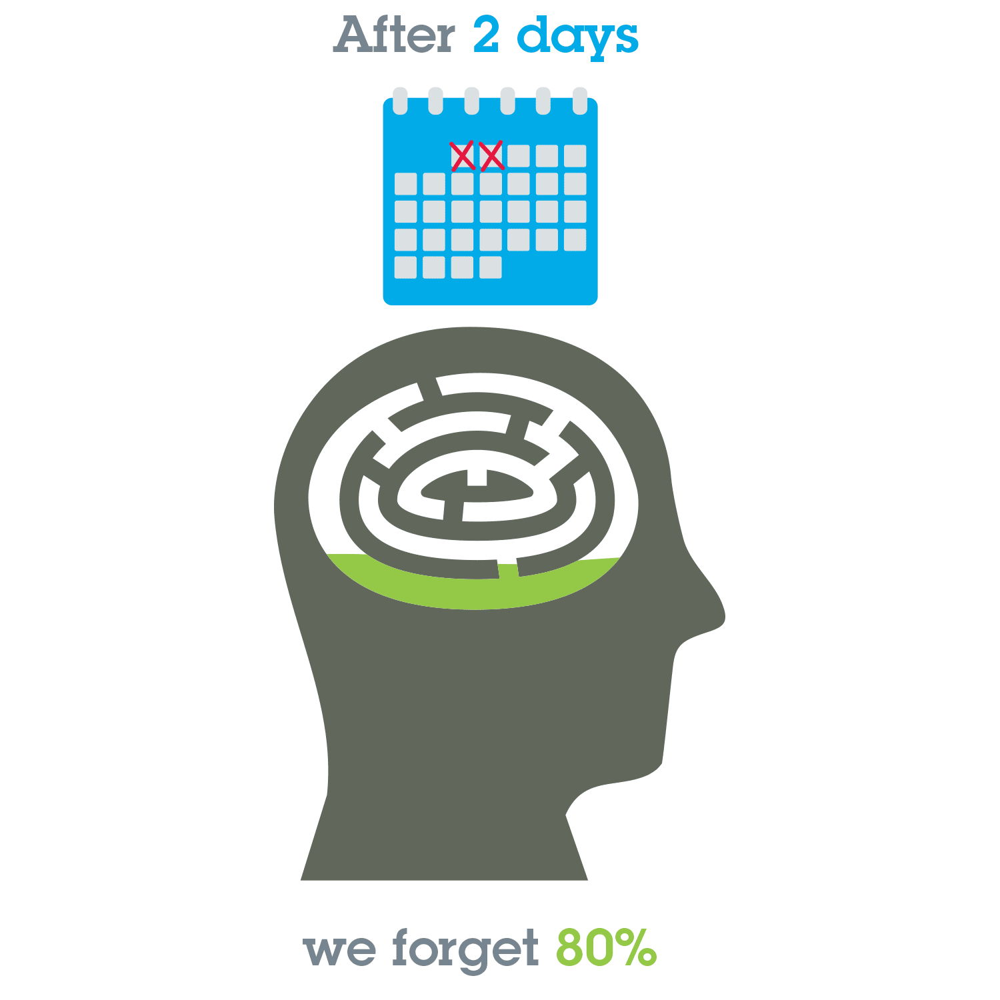
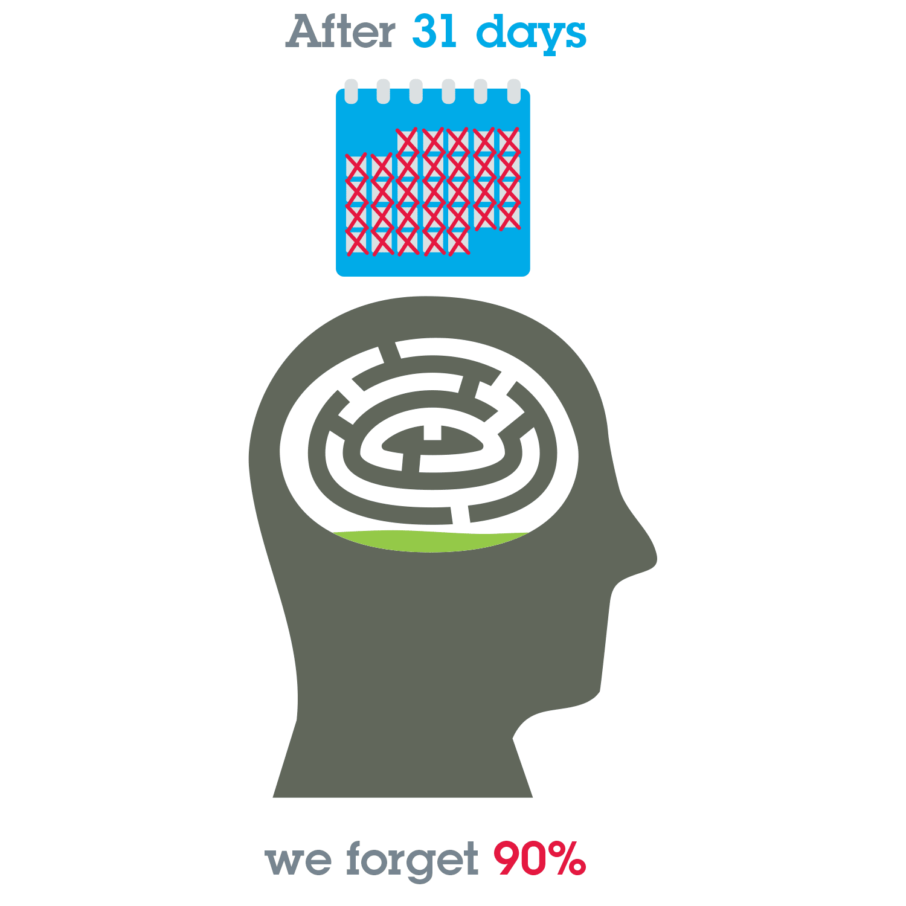
Application – Learning Effectiveness
Notes:
We’ve all experienced it. We go to a great class or conference. We get a ton of incredible information. We get motivated and charged up about everything we learned. Then, we get back to our job, get sidetracked with day-to-day responsibilities and don’t take the necessary opportunity to reinforce what we learned while we were away. And because of that,
we forget.
And it turns out, it’s quite normal to forget. (see Forgetting Curve graphic in ppt)
According to the Ebbinghaus Forgetting Curve:
• Without context, 50 percent of what we learn is forgotten in one hour
• 80 percent is forgotten after two days
• 90 percent is forgotten after 31 days
So, if you thought that a portion of managers sent away for an event would be able to come back and apply the learnings … unless the learning is reinforced, just a measly 10 percent of knowledge will be retained after a month. Was it worth it? The time away from the office, the travel expense, the extra stress on the employee and teams. And what do you have to show for that 10 percent?

Slide 9
The Forgetting Curve by Hermann Ebbinghaus
Retention (%)
Event Investment of $100,000
Immediate Recall
Without context, 50% is forgotten in 1 Hour
$50,000
20 Minutes
90% is forgotten in 31 Days
$90,000
1 Hour
70-80% is forgotten in 2 Days
$80,000
9 Hours
2 Days
6 Days
31 Days
Elapsed Days Since Event
Notes:
Hermann Ebbinghaus (January 24, 1850 — February 26, 1909) was a German psychologist who pioneered the experimental study of memory, and is known for his discovery of the forgetting curve and the spacing effect. He was also the first person to describe the learning curve.

Slide 10



Spending is Misaligned
We know most of the value of learning comes from pre-work and follow-up.
Yet most organizations invest disproportionately in the event itself.
Learning’s Value to the Learner
Pre-Work: 26%
Event: 24%
Follow-Up: 50%
Investment Proportion
10%
85%
5%
Source: The Promise of Phase 2 by Jack Zenger, Joe Folkman and Robert Sherwin, T&D Magazine
Notes:
Compounding these challenges is the fact is that there has been and continues to be a mismatch in where we as companies and as an industry spend most of our money versus where the learner gets the most value. The studies show that learners get the most value from the pre-work and follow-up work… more than 75%. Only 24% of the value ultimately comes from the event itself.
Yet, we spend 85% of our dollars in the event and only 15% in the areas where it counts most when it comes to making the learning stick. Why do we do this? It’s not that we don’t understand it. We do it because the events are expensive to conduct and takes time to put together. We don’t have much in the way of time or money for the other stuff.

Slide 11
Why?
“Learning is experiencing a powerful transformation. No longer limited to instructor- led events and static eLearning, technology has enabled a dynamic mix of interactive experiences where individuals can learn at their own pace and get the information they need, just the way they want it, exactly when they need it. This provides new horizons for business for organizations willing to invest in learning technology to empower their employees.”
Mike Cooke
Chairman and CEO, Brandon Hall Group
Notes:
Our ability to respond to this learning crisis by implementing new mindsets and processes will determine our success.
According to CEB: HR is Facing a Lot of Change:
More demand for improved analytics to manage the workforce
New Technologies continue to emerge
Diversity of preferences, expectations and needs of critical talent
These new mindsets incorporate taking a more business minded approach to those processes requiring us to execute with a new discipline.
UPS has always demonstrated leadership in the learning space – hoping to expand upon that in light of the change in the business environment we face and UPS’s updated learning strategy as you all look to build out your next 5 year strategic plan.
Update intake form to reflect the new “business mindset”

Slide 12
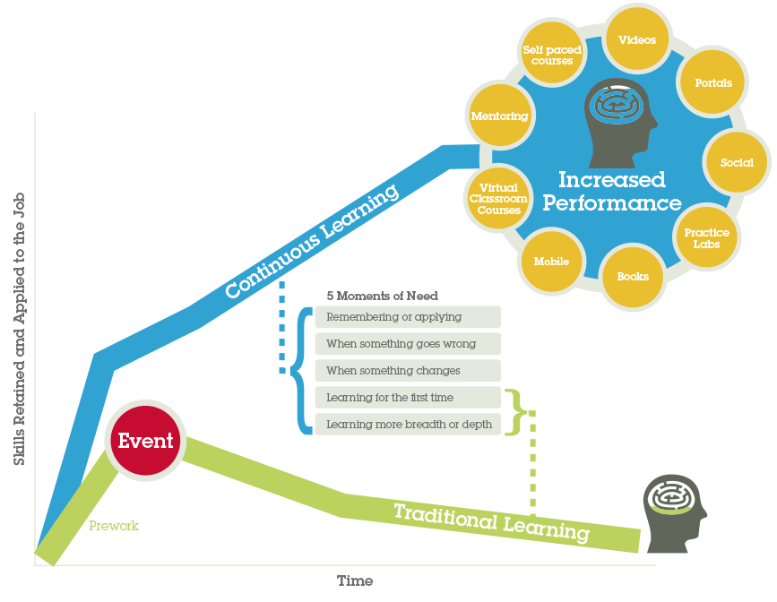
The Best Embrace Continuous Learning
Notes:
Two flavors of CL that Capgemini will be sharing

Slide 13
Exercise / Reflection:
Select one of your existing programs:
Think about what you do to support continuous learning at different points within the learning journey:
PRE: ………..
DURING: ……………..
POST: ………….

Slide 14
The Capgemini Approach to Continuous Learning
Several factors influenced the need to define a POV on continuous learning
Pressure from the business to reduce costs and to show improved value
The availability of online training but few people following learning paths on their own
Lack of checkpoints with the learner to gauge understanding
To address these challenges, we developed the Facilitated Virtual Learning Journey (FVLJ)
Includes both synchronous and asynchronous learning interventions
Program structured with finite start and end dates
Scaffolding through various supporting devices – ex., assignments, coaching
Peer-to-peer and peer-to-SME interactions
Two examples of this type of learning program:
Project Management Professional (PMP) FVLJ
People Connect FVLJ
Notes:
We’ve refined this model over a number of years

Slide 15
PMP Program Structure (FVLJ)
Active project manager or team lead Application for EM Certification in process Eligible for PMP Certification
10 Weeks (with Kick-off in advance to explain PMP application process)
Able to apply PMBOK principles An active contributor to the EM Community PMP Certified
PMBOK 1 - 3
PMBOK 4 - 5
PMBOK 6 - 7
PMBOK 5 - 7
PMBOK 4*
PMBOK 9, 10, 13
PMBOK 12
PMBOK 8
PMBOK 11
Code of Ethics
Indiv. Pre-work
SA
SA
SA
SA
SA
SA
SA
SA
SA
Sample Test
PMP Exam
PMP FVLJ Kick-off (1 hr)
Intro, Basics
Init., Scope Plan
Sked, Cost Plan
Scope, Sked, Cost Cntrl & Mgmt
Integ Mgmt & Close
HR, Comms, Stkhldr Mgmt
Procure ment Mgmt
Quality Mgmt
Risk Mgmt
Ethics, Review & Close
Group Required
PMP Application Accepted
WBLs
1 - 3
WBLs
4, 7, 8
WBLs
10 - 13
WBLs
9, 12*,14
WBLs
5 – 6*
WBLs
17- 20 27, 28
WBLs
25, 26
WBLs
15, 16
WBLs
21 - 24
WBLs
29, 30
Indiv Suggested
OJT
Reading Assessment
Self Assessment
Virtual Classroom
eLearning
On the Job Training
Cert
*Topic covered in more than one session Reading- 1 to 2 hours per chapter Self Assessments- approximately 20 minutes each Virtual Classrooms- 90 minutes each
Notes:
Key points for PMP
Setting the right expectations is critical. Participants should understand this is a different way of learning: they drive, and we accompany
The objective is certification, and we want learners to take the program seriously. Therefore, we ask them to complete their PMP applications before the series starts
“Week 0” intro session to share this information and to establish a moral contract with the learner

Slide 16
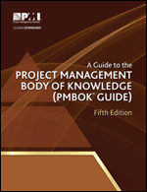
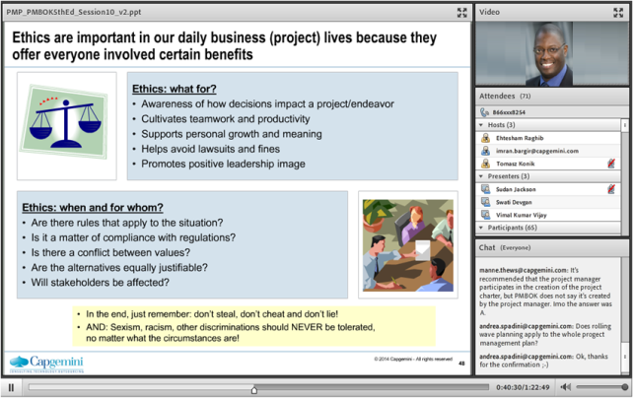
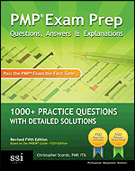
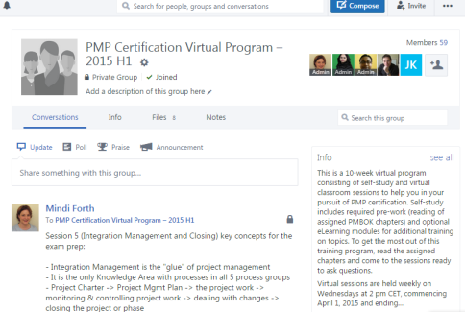
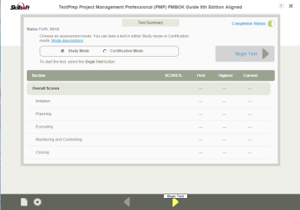

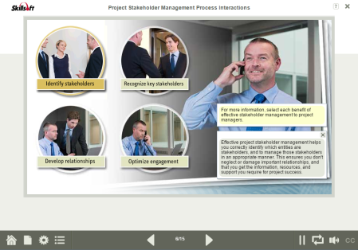
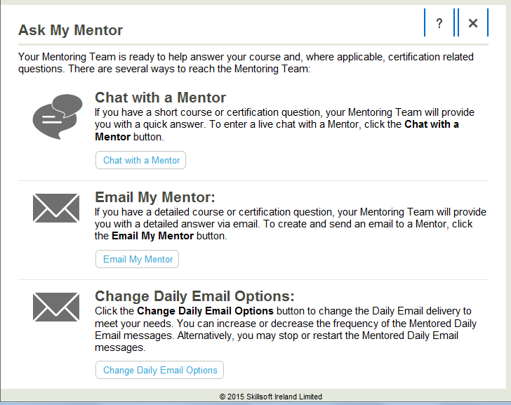
PMP FVLJ: A Closer Look
This is followed by a virtual session where
participants engage with a SME
Each topic starts with an assigned PMBOK® section(s) and review questions
Participants are asked to reflect on the principles and apply them on their projects
At any time, learners can interact with other participants and SMEs through Yammer
At the end of
the session, participants are provided with self-paced learning from Skillsoft
Notes:
The foundation of the program is the Skillsoft learning assets for PMP certification. The only content we have created are the presentations to support live sessions.
The content has been logically organized and represented on a online learning map (housed in our SumTotal LMS), and links point directly to the items on the Skillport platform
Everything was already available to us. We added the technology to enable the learning and empower the learning

Slide 17
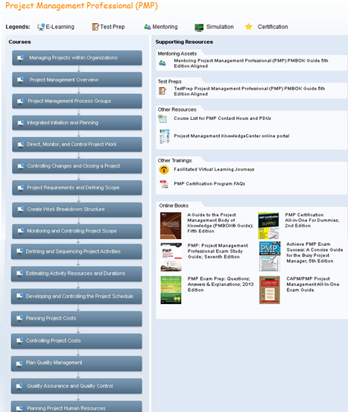
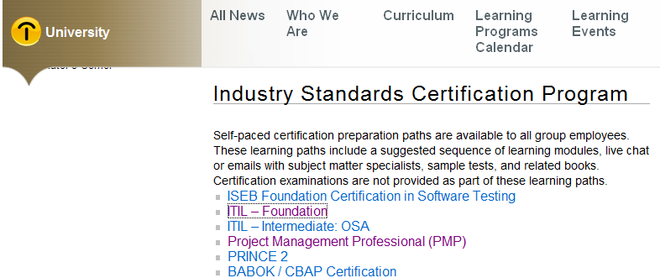
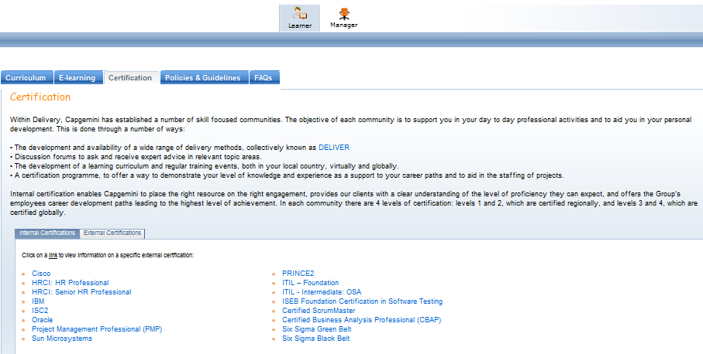
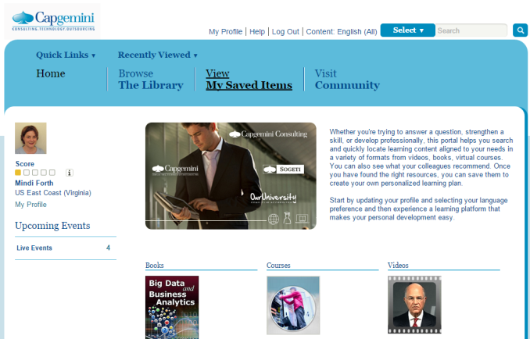
PMP Learning Anytime, All of the Time
Notes:
Whether an employee enters through our intranet or LMS, they arrive at the learning map. The links direct them to content on the Skillport platform.

Slide 18
People Connect FVLJ
The objective of the People Connect FVLJ
People Connect is a program targeted for younger team managers. It focuses on the performance management and people development of their team members
A first level of evaluation is performed by polling subordinates of managers attending the People Connect program: once just before the program starts and then again three months after the program is completed
This approach shows a serious intention and commitment to the professional development of our newer managers
This isn’t a simple “check-the-box” training assignment
Trust of the subordinates and managers that responses are submitted anonymously and used for the sole purpose of professional development
Manager is given assignments to use on the job and asked to report back, requiring reflection
Notes:
Effectiveness optimization (pre, during, post)
88% of the respondents stated that they have observed positive change in their Manager’s Performance Management Competencies over a period of 3 months after the program.
23% of total respondents opined that their Managers had developed an encouraging & positive attitude which helped them perform better in the last 3 months.

Slide 19

People Connect FVLJ
People Manager Role Definition & Coaching
Effective Listening
Giving & Receiving Feedback
Motivating & Influencing Others
Conflict Management, Problem Solving & Negotiation
Career Development
The program has 6 modules. Each module is supplemented with distinct e-learning courses. Each topic concludes with a on-the-job assignment.
At the end of the entire program, participants take a ‘Readiness Assessment’ which evaluates their understanding of the concepts taught.

Slide 20
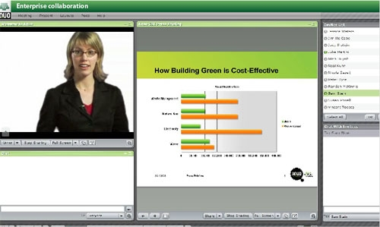
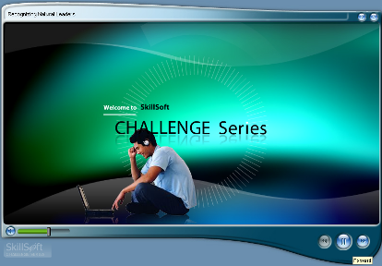
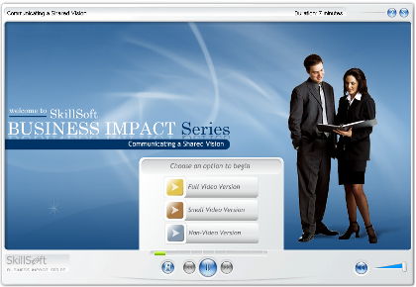



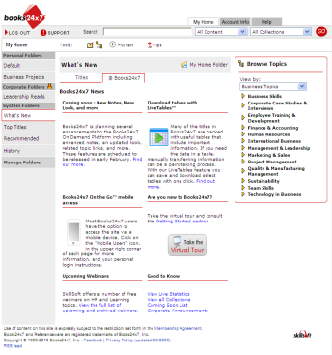



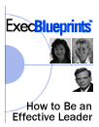



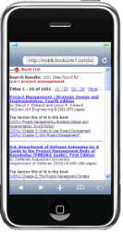


People Connect: A Closer Look
At the end of
the session, participants are given one hour of self-paced learning from My Learning resources
Each topic starts with a virtual session
A virtual session where
Participants are explained the concepts
On-the-job assignments are given at the end of each topic
Notes:
We appreciate that you have “day jobs” as consultants which consume your time….so we have focused the formal learning of this development program to be in small, “digestible” bites
and in several different forms to keep you engaged in learning.
Occasionally, we will request you take a web-based module, but usually they are short in duration (10 minutes or less)
we also have other wonderful learning assets in MyLearning we will introduce you to that are relatively quick to complete.
For example, SkillBriefs are usually 1-2 page “cheat sheets” to help refresh your memory (e.g., what does the acronym for SMART Goals stand for?).Executive Summaries are usually 6-8 page synopsis of a best selling book that is pertinent to a Touchpoint topic. (discuss others)….

Slide 21
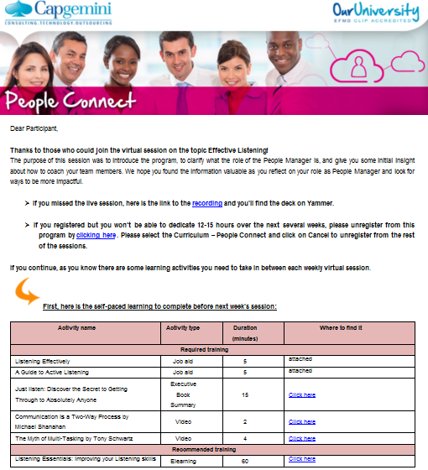
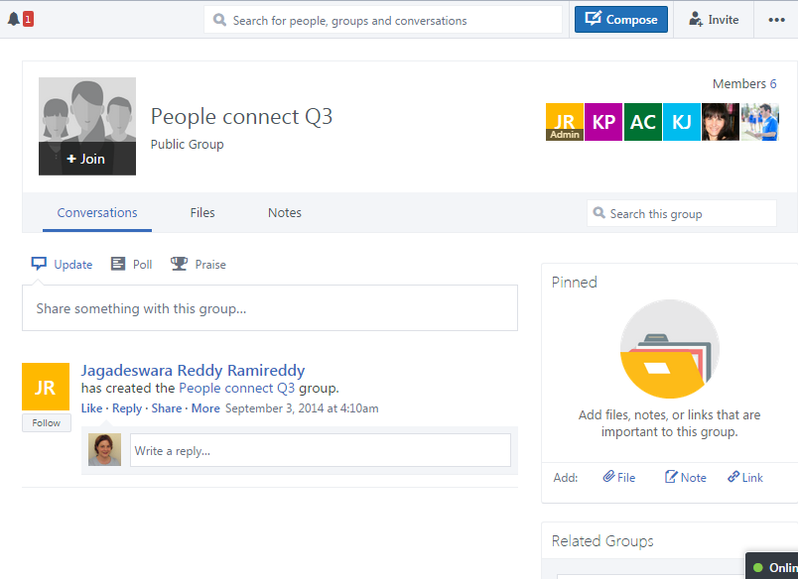
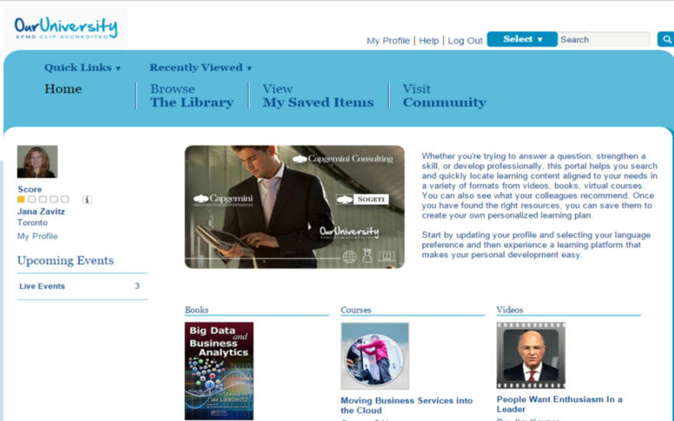
People Connect: Learning Just a Click Away
Notes:
All content is included in a weekly Job Aid (internally created) for each of the six topics

Slide 22
An FVLJ is a combination of virtual learning interventions that addresses the learning objectives of a learner between two points.
Pre-Assessment
Learning Interventions (spanning weeks or months)
Post-Assessment
Group (Required)
Kick-off
Virtual Sessions
Virtual Teamwork (Group Assignments)
Closing Sessions
Individual (Required)
Participant Qualification
Acceptance into FVLJ
ELearning
Individual Assignments
Assessment or Exam
Certification (if offered)
Individual (Recommended)
Technologies to support FVLJ learning interventions include: Live Meeting Adobe Connect Yammer
OJT
Virtual Coaching
Self-study
Notes:
A learning journey that combines synchronous and asynchronous virtual learning interventions with a strong component of self-directed learning. The learner is actively guided by a facilitator and supported by SMEs throughout the journey to ensure the learning objectives are successfully met.
The FVLJ is structured with a defined start and end that includes a knowledge assessment and has intermediate checkpoints to sustain momentum with the learners.

Slide 23
Definition: Facilitated Virtual Learning Journey (FVLJ)
Facilitated Virtual Learning Journey (FVLJ) Definition
It is offered as a global program in order to create an international experience and reach a maximum number of participants across the target population. Each FVLJ is no longer than twelve weeks in duration and includes a maximum of 200 participants per live session, with no more than 1,000* targeted participants per run. A series of FVLJs can be combined to deliver a larger, more complex program.
Consisting of
Facilitated virtual session to kick-off the learning journey
Individual study interspersed by facilitated virtual sessions used as “checkpoints” and to provide SME guidance
Participant-driven “on the job training” (OJT) as a means of applying recently acquired knowledge and skills
Facilitated virtual session to close the learning journey experience and prepare participants for certification
Leveraging
Existing content (eLearning, videos, book extracts, documents, assignments, Capgemini proprietary content)
Content that is prone to repeated delivery over time
Video and audio conferencing technologies
Social collaboration tools such as Yammer
Supported by
Our University with respect to Operations and University Virtual Qualified Facilitators (UVQF) processes
Regions with respect to Communications, Promotion, Impact Measurement, and providing access to SMEs/VUQFs
Both Our University and Regions for Content Design
* Above 1,000 targeted participants, consider an asynchronous learning journey.
Notes:
A learning journey that combines synchronous and asynchronous virtual learning interventions with a strong component of self-directed learning. The learner is actively guided by a facilitator and supported by SMEs throughout the journey to ensure the learning objectives are successfully met.
The FVLJ is structured with a defined start and end that includes a knowledge assessment and has intermediate checkpoints to sustain momentum with the learners.

Slide 24
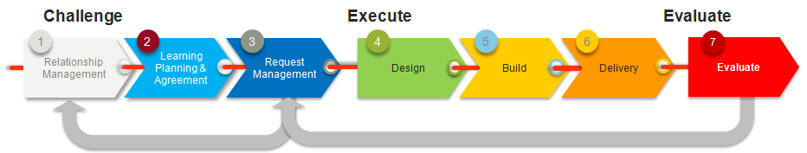
ALIGNing learning with business needs
The FVLJ POV on the previous slide and all of our internally developed learning programs are supported by a structured governance and processes: The Align Framework.
Our Align framework documents the process, starting with a business case and going all the way through measuring the business impact of learning solutions. It consists of:
Understanding the business problem
Specifying what a successful solution would bring to the business (KPIs)
Designing for maximum learner’s engagement
Delivering the learning solution according to deployment plans
Measuring the business impact
Improving the learning solution

Slide 25
EvaluateIt is a 4-level evaluation framework
Relevance, Experience and Intent to apply
Like It
Knowledge Acquisition and Retention
Behavior and Individual Performance
Adoption and Business Performance
Know It
Show It
Impact It
Validated by external PhD
Notes:
EvaluateIT leverages the best of two industry standards Kirkpatrick* and Bersin
All levels of evaluations will NOT be applied to all learning programs.
EvaluateIt is moving to OptimizeIt

Slide 26
The EvaluateIt framework is embedded throughout the University Align framework
Challenge
Execute
Evaluate
1
2
3
4
5
6
7
Relationship Management
Learning Planning & Agreement
Request Management
Design
Build
Delivery
Evaluate
Learning Plan
Business Case
Program Design
Deployable Learning Package
Delivered Programs
Evaluation Results
IDENTIFY -Business metrics and overall evaluation strategy defined in business case
DESIGN - Detailed evaluation approach defined during design
BUILD - Detailed evaluation approach defined during design
COLLECT - Systematic use of ‘Like It’ after each delivery, storage of data, and integration of course ratings in reporting
ANALYZE & RECOMMEND -Periodic analysis and identification of findings to drive action
Notes:
Not all findings result in implications associated with ‘Request Management’ (e.g., course enhancements, re-design). Some findings revert back to ‘Relationship Management’ working with stakeholders or other impacted business functions to address (e.g., HR)

Slide 27
Exercise:
Select one of your existing programs:
How would you optimize the effectiveness of that program?
PRE: ………..
DURING: ……………..
POST: ………….
Notes:
How could you monetize this? (Time savings, hard costs, other?)
Intake form takeaways?
Technology Checklist?

Slide 28
What continuous learning success looks like
Notes:
When we learn better, we do better – when we do better, our organization performs better – leading to real business results
http://www.skillsoft.com/assets/offers/elearning-guide/ p19
Success
is created through intentional
leadership, making the right tools
and resources accessible and
putting defined business processes
in place to deliver real-time
information to the workforce, so
employees can solve business
problems and achieve results.
Real breakthroughs in performance
are realized only when organizations
move away from a “usage equals
value” mindset to an operating
model that perpetually promotes
continuous learning through
effective engagement and tight
alignment. This leads to adoption
of tools enabling employees to
deliver an added value to the
enterprise. Online solutions are ripe
for delivering this type of value;
value grounded in efficiency and
effectiveness leading the tangible
business outcome

Slide 29
Conclusion –Putting the pieces together
Puzzle completion
Synthesize Share ACT
30 second overview to recap what you will do differently when you go back to their organization – “aha”/”quick win”
Handouts:
Best Practices Checklist
Business Case template (intake process)
Optimizing event based learning tips
Notes:
Best Practices summary:
Mindset shift
Know your content!
Think through the “holistic” process (not just content design)
*Add in reflection time in ID process – shift leaner from passive to active learner mindset
*Business Case mindset – not just “training” mindset – shapes outcome
Beyond the “program”, what’s happening behind the scenes
Stay Curious
Experiment
Continue to refine
Look for opportunities to find “context”
Manager Expectations
*Alignment with Biz obj/sponsorship
*Supporting the learner before, during, post “event”.
*Learner Expectations-moving from passive learner to active participant (examples)- commitment contract, positioning courses with potential learners up front before they are confirmed lay out (example PMP Cert – approval from Manager, develop your application and think through your attributes that make you PMP worthy, asked to be approved by PMI before exam before they register for the journey). Manager expectations are raised to consider employee
CEU’s (Continuing Education) Manager oversees this process
Learning Environment?
manager involvement, applying with customer interactions
Examples to illustrate -
*How you will measure/communicate success
Technology
Engage early in the business cycle
Decide where you can play role of “Learning Architect”
Stay curious
Don’t be afraid to experiment

Slide 30
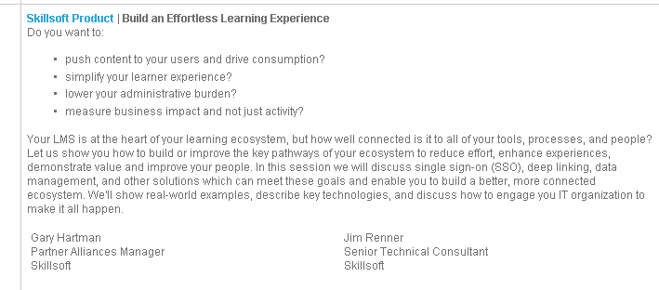
Tuesday, May 19 4:10-5:10

Slide 31





Thank you!

